Slide 1
Implementing Snake Game
On FPGA
By: Bernard Stein, Isabel Warth, and Michael Kalu

Slide 2
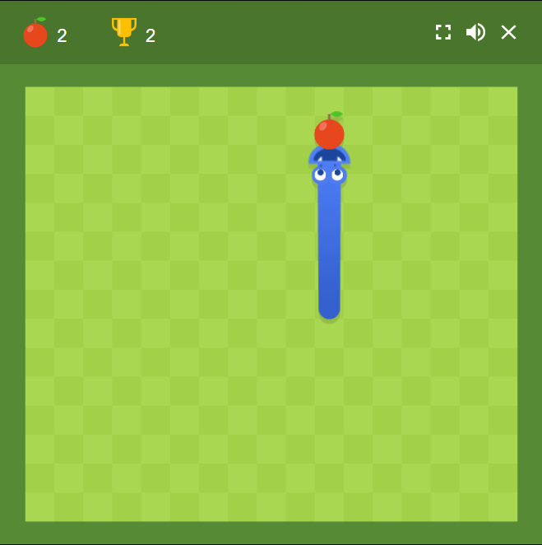
Abstract
Snake is a popular game with many implementations. The player controls a snake on a plane growing as player collect object and avoids obstacles like borders and the snakes tail. Variations include having portals that move the snake from one side to the other like Pac Man. This project covers implementing Snake written in Verilog with aNexys A7-100T FPGA board and a VGA monitor.

Slide 3
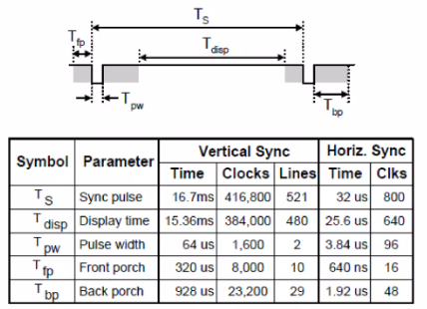
VGA Specifications
The resolution decided for this project is 640-pixel by 480-pixel as it is a manageable size and an achievable clock speed. Although 25.175 Mhz is specified, in our finding we found that 25 Mhz is close enough without causing problems and it is easier to generate. A clock divider on the 100 Mhz system clock achieves the required frequency without the use of PLL or MMCM.

Slide 4
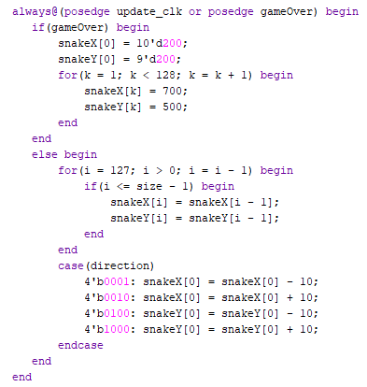
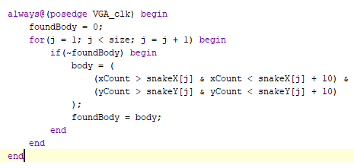
Game Loop and Object Creation

Slide 5
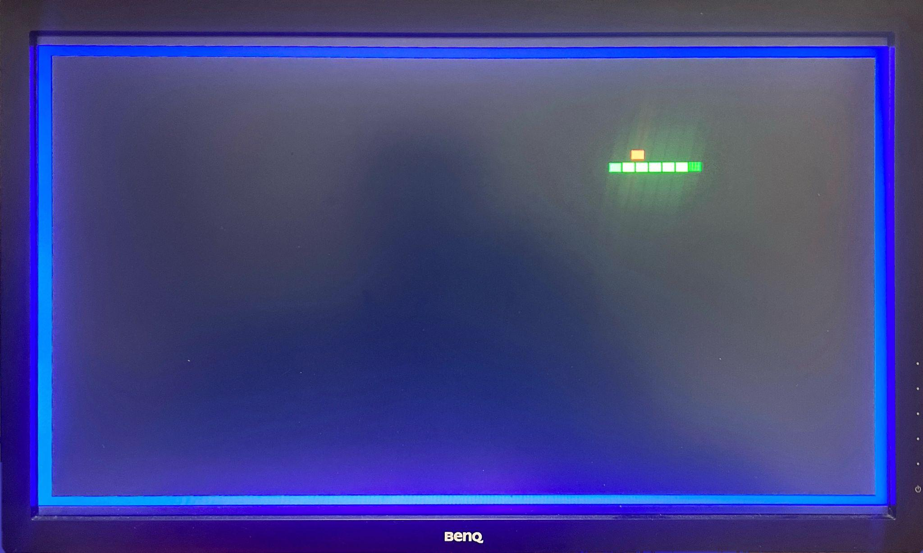
Final Result

Slide 6
References
Snake Game on FPGA in Verilog: www.slideshare.net/sskrishnajith/snake-game-on-fpga-in-verilog
"Snake" on an FPGA: www.instructables.com/Snake-on-an-FPGA-Verilog/

